Slide 1
OCP Chapter1 Advanced Class Design
By: elsayed zahran

Slide 2
Content
1- Reviewing OCA Concepts.
2- Using instanceof.
3- Understanding virtual method invocation.
4- Annotating overridden methods.
5- Coding equals, hashCode and toString.
6- Working with Enums.
7- Creating Nested Classes.

Slide 3
Reviewing OCA Concepts
Can Access | Public | Private | Protected | Default
Member in the same class | Yes | Yes | Yes | Yes
Member in another class in same package | Yes | No | Yes | Yes
Member in a super class in different package | Yes | No | Yes | No
Member in a class (that is not a superclass) in a different package | Yes | No | No | No
Access modifiers

Slide 4
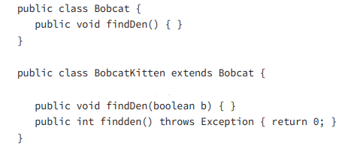
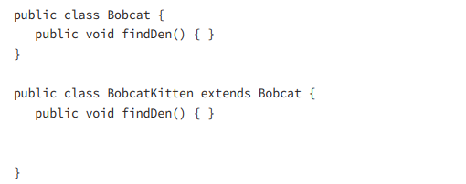
Reviewing OCA Concepts
Overloading
overriding
Two or more methods with the same name and different parameter list.
Two or more methods with the same name and parameter list.
Note: static methods can’t be overriding.

Slide 5
Reviewing OCA Concepts
Abstract class may or not contain methods.
Methods can be abstract or concrete.
The first concrete subclass is required to implement all abstract methods.
Abstract Class

Slide 6
Reviewing OCA Concepts
static
final
static makes a variable shared at the class level and uses the class name to refer to a method.
final prevents a variable from changing or a method from being overridden or class from being inherited.

Slide 7
Using instanceof
instanceof is an operator that is used to determine whether an object is an instance of a particular class Or Subclass that derives from specific class.

Slide 8
Virtual Methods
In Java, all non-static methods are virtual by default.
This means that when you call a method on an object, the actual implementation that gets executed is determined at runtime based on the actual type of the object.

Slide 9
Annotating overriding
In Java, you can use annotations to provide additional information about code elements, including methods.
When it comes to annotating overridden methods, there's a specific annotation called @Override that you can use to indicate that a method in a subclass is intended to override a method in its superclass.

Slide 10
Coding equals, hashCode, and toString
The toString() method is a built-in method provided by the Object class.
This method is used to obtain a textual representation of an object.
It's often overridden in subclasses to provide more meaningful information about the object's state.
toString

Slide 11
Coding equals, hashCode, and toString
In Java, the equals() method is a built-in method provided by the Object class.
it's used to compare the contents or values of two objects to determine if they are equal.
By default, the equals() method in the Object class performs reference equality.
equals

Slide 12
Coding equals, hashCode, and toString
In Java, the hashCode() method is a built-in method provided by the Object class.
The hash code is typically used for efficient storage and retrieval of objects in data structures like hash tables.
Objects that are equal (according to their equals()) must return the same hash code. Different objects do not need to return different hash codes.
hashCode

Slide 13
Coding equals, hashCode, and toString
hashCode Contract:
Within the same program, the result of hashCode() must not change.
If equals() returns true when called with two objects, calling hashCode() on each of those objects must return the same result.
If equals() returns false when called with two objects, calling hashCode() on each of those objects does not have to return a different result.
hashCode

Slide 14
Enums
Enums, short for enumerations, are a special data type in Java used to represent a fixed set of named constants.
They provide a way to define a set of predefined values that a variable can take, making your code more readable and maintainable.
Example:
public enum Season { WINTER, SPRING, SUMMER, FALL}
Season s = Season.SUMMER;

Slide 15
Enums
Enum Methods:
Enums can have methods just like classes.
You can define abstract methods for enums, and each constant provide a different implementation.
Constructors: Enums can also have constructors.
Each constant can have its own constructor implementation.

Slide 16
Enums
Benefits of Enums:
Readability: Enums provide meaningful names for constants, making code more readable.
Type Safety: Enums are type-safe, preventing you from using arbitrary values that aren't part of the predefined set.

Slide 17
Nested Class
A nested class is a class that is defined within another class.
There are four types of inner classes:
Member inner class
Local inner class
Anonymous inner class
Static nested class

Slide 18
Nested Class
A member inner class declaration looks like a stand‐alone class except that it is located inside another class:
Can be declared public, private, protected or default.
Can extend any class and implement interfaces
Can be abstract or final
Cannot declare static fields or methods
Can have the same variable names as outer classes.
Can access members of the outer class including private member
Member inner class

Slide 19
Nested Class
It is a nested class defined within a method, Like local variables, a local inner class declaration does not exist until the method is invoked:
They do not have an access specifier.
They cannot be static and cannot declare static fields or methods.
They have access to all fields and methods of the enclosing class.
They do not have access to local variables of a method unless those variables are final or effectively final
Can access members of the outer class including private member
Local Inner Classes

Slide 20
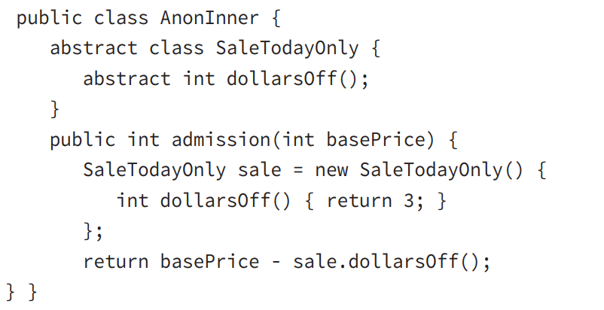
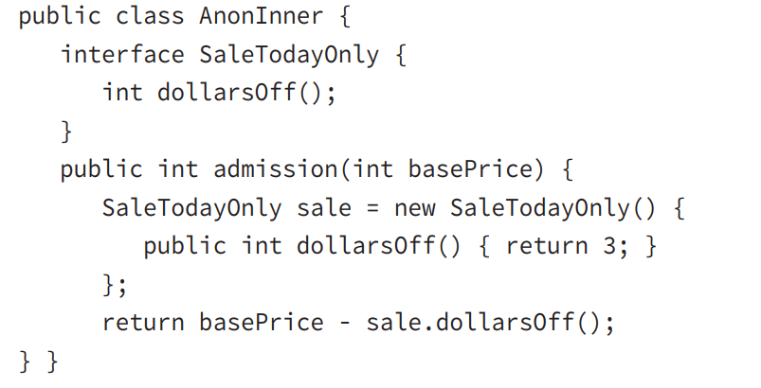
Nested Class
It is a local inner class that does not have a name.
It is declared and instantiated all in one statement using the new keyword.
Anonymous inner classes are required to extend an existing class or implement an existing interface.
Anonymous Inner Classes

Slide 21
Nested Class
It is a static class defined at the member level.
It can be instantiated without an object of the enclosing class example: new Outer.var
The nesting creates a namespace because the enclosing class name must be used to refer to it.
It can be made private or use one of the other access modifiers to encapsulate it.
Static Nested Class

Slide 22
Nested Class
It is a static class defined at the member level.
It can be instantiated without an object of the enclosing class example: new Outer.var
The nesting creates a namespace because the Outer class name must be used to refer to it.
It can be made private or use one of the other access modifiers to encapsulate it.
The inner class has access to all fields in the Outer class.
Static Nested Class

Slide 23
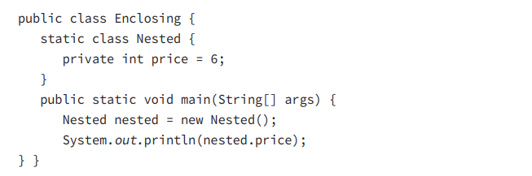
Nested Class
Static Nested Class

Slide 24
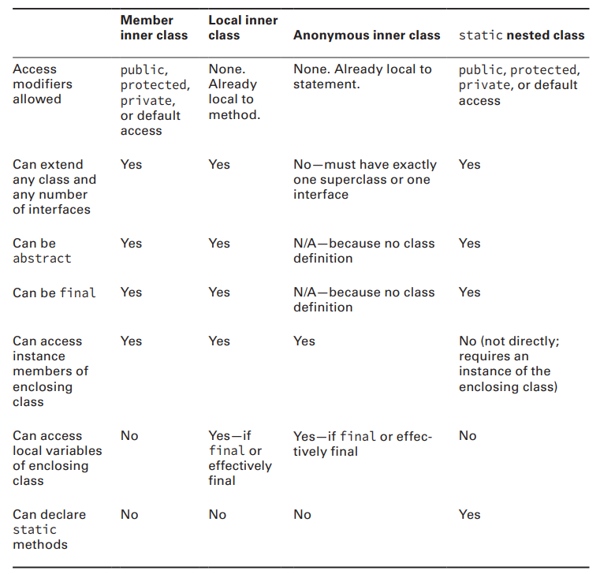
Nested Class
Summary

Slide 25

Which of the following statements are true, assuming a and b are String objects? (Choose all that apply.) A. If a.equals(b) is true, a.hashCode() == b.hashCode() is always true. B. If a.equals(b) is true, a.hashCode() == b.hashCode() is sometimes but not always true. C. If a.equals(b) is false, a.hashCode() == b.hashCode() can never be true. D. If a.equals(b) is false, a.hashCode() == b.hashCode() can sometimes be true.
REVIEW QUESTIONS

Slide 26
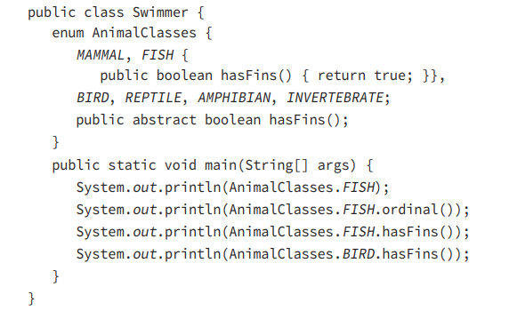
A. fish B. FISH C. 0 D. 1 E. false F. true G. The code does not compile.
REVIEW QUESTIONS

Slide 27
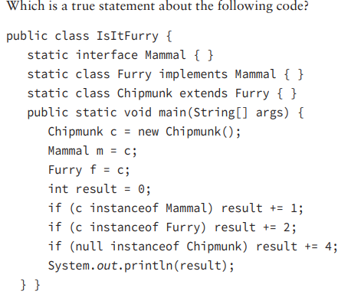
A. The output is 0. B. The output is 3. C. The output is 7. D. c instanceof Mammal does not compile. E. c instanceof Furry does not compile. F. null instanceof Chipmunk does not compile.
REVIEW QUESTIONS

